Slide 1
Learjet Investigations during the 2019 UAEREP Field Campaign and Potential for Rain Enhancement through Stimulation of a Secondary Ice Process

Slide 2
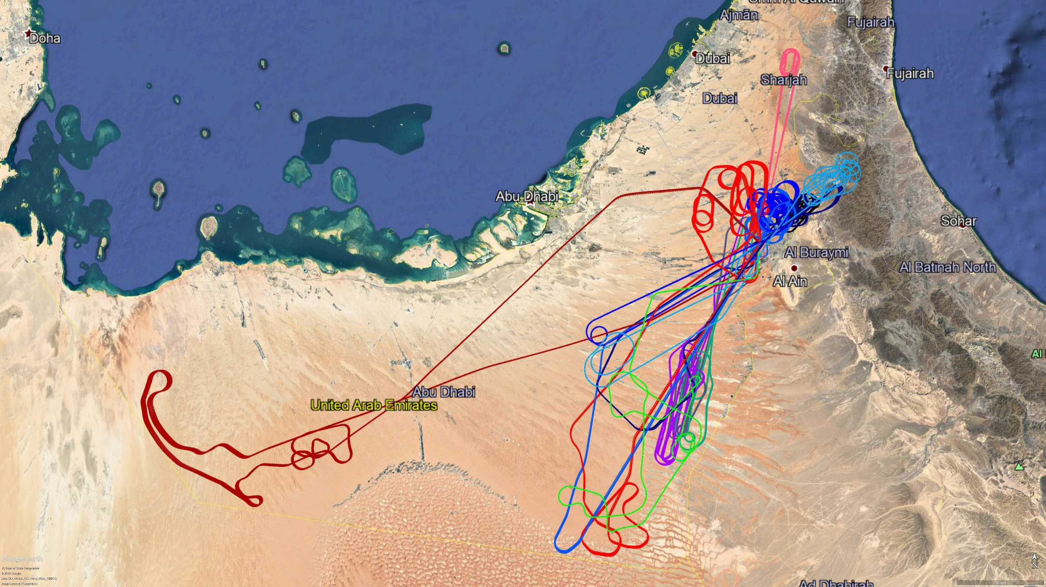
Learjet Flight Tracks during the August 2019 UAEREP Field Campaign
UAE Research Program for Rain Enhancement Science

Slide 3
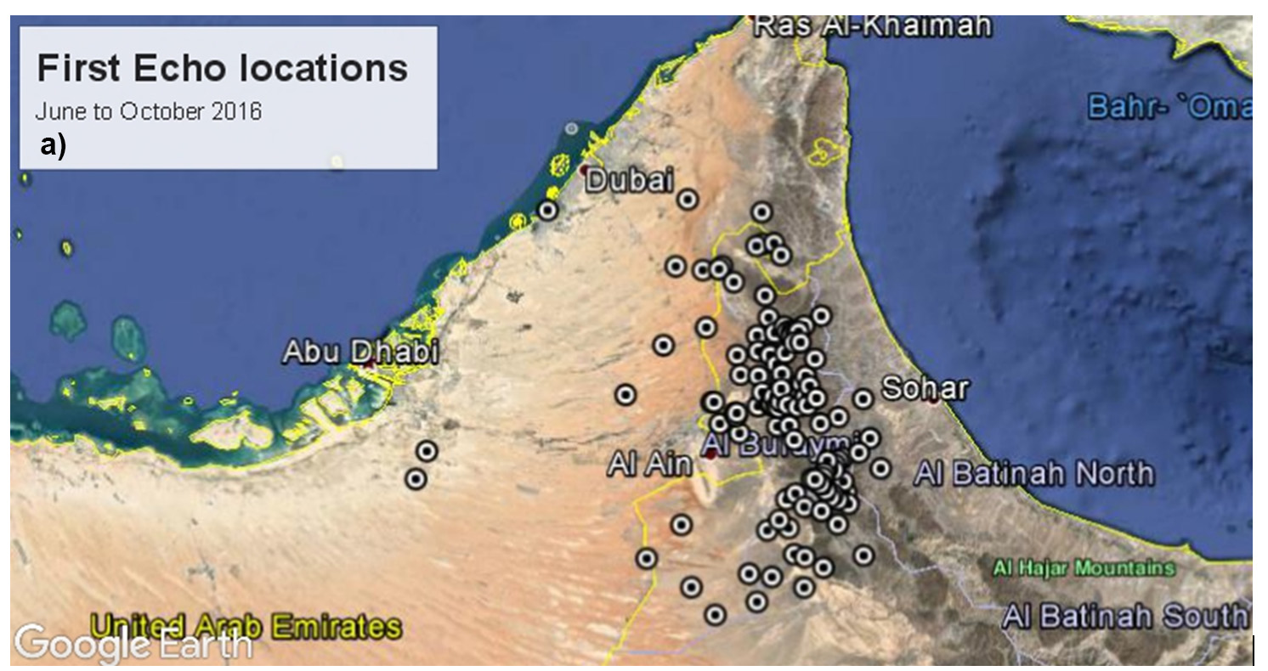

Slide 4
Ice formation modes in the atmosphere
Korolev 2023
Homogeneous ice nucleation: Spontaneous freezing of water droplets or aqueous aerosols.
Heterogenous ice nucleation: Freezing that occurs with the aid of ice nucleating particles (INP).
Secondary ice production: formation of atmospheric ice via processes involving pre-existing ice particles.
Two-stage process
Primary ice production
(PIP)
heterogeneous/homogeneous
nucleation of INPs
Secondary ice production
(SIP)
Notes:
Secondary ice production is a two-stage process, which begins with homogeneous or heterogeneous ice nucleation. After the initiation of primary ice, if the conditions are favorable, secondary ice production may follow. Secondary ice production is defined as a process of formation of atmospheric ice involving pre-existing ice particles.

Slide 5
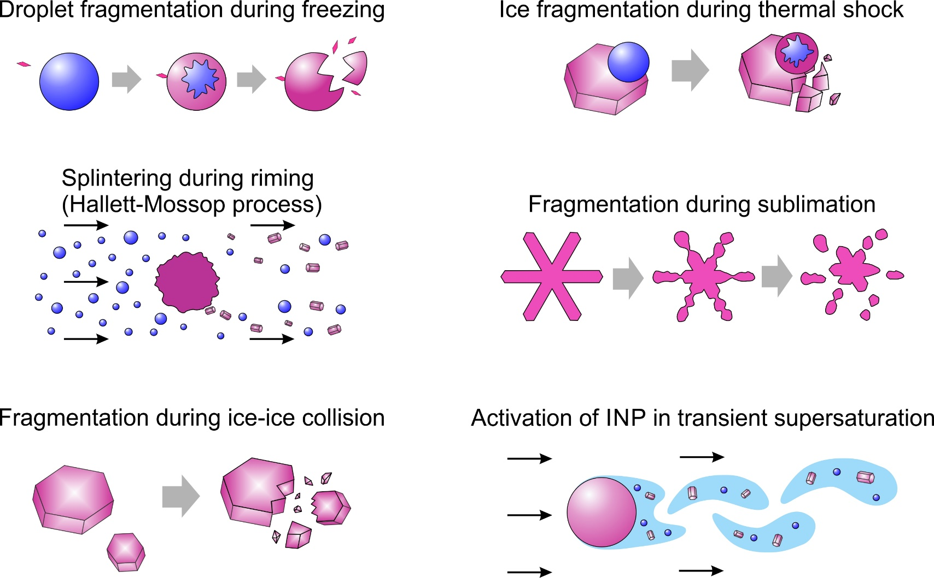
Recognized SIP mechanisms
Korolev and Leisner, ACP, 2020
Notes:
Presently, there are six recognized SIP mechanisms, which could be activated in the troposphere. A detailed review of these mechanisms can be found in Korolev and Leisner, 2020.

Slide 6
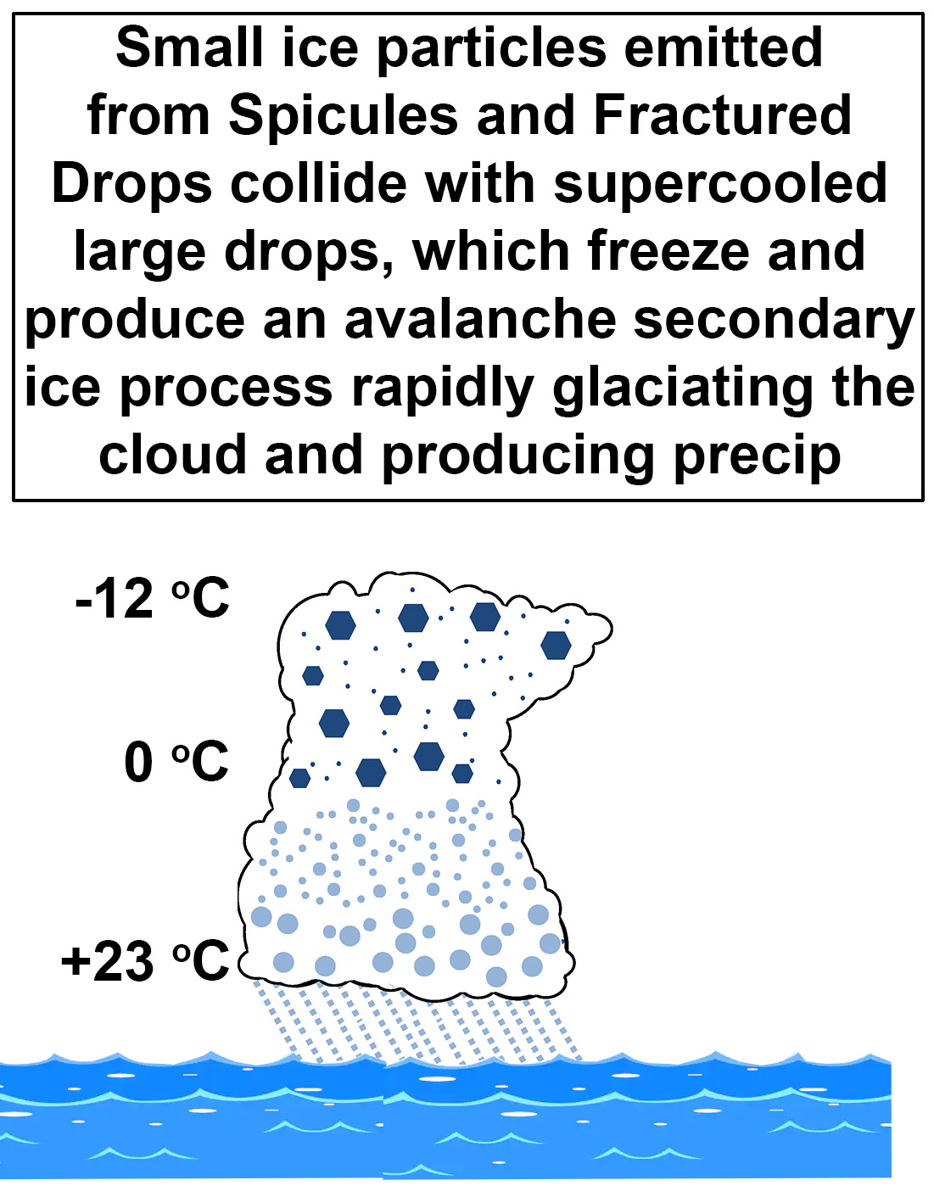
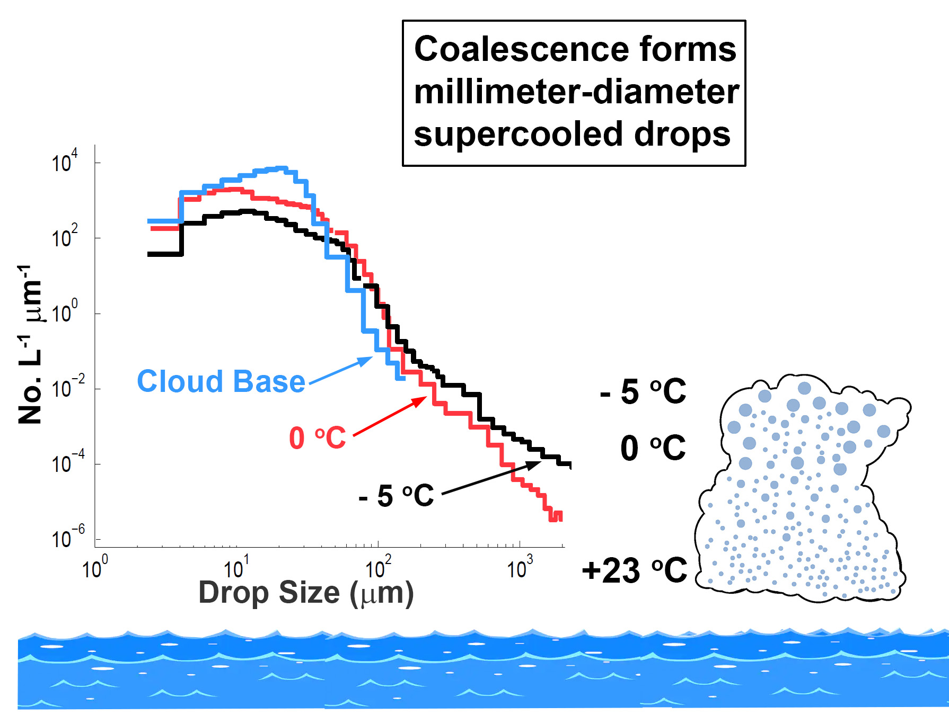
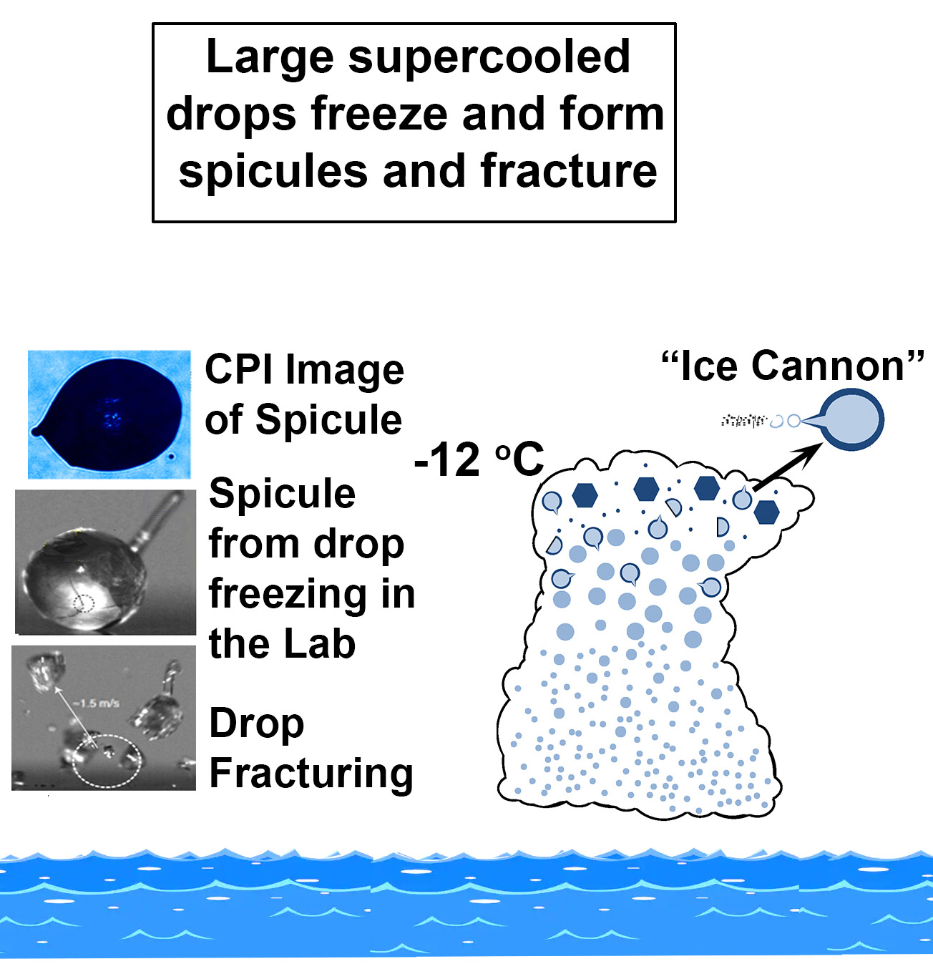
A Secondary Ice Process (SIP) that Exists Naturally
in Tropical Maritime CuCg Clouds
Supercooled Large Drops freeze, produce Spicules, Fractured Drops and Small Ice Particles that start an Avalanche Seeding Effect (Lawson et al. 2015, 2017, 2022a, 1923))
QUESTION: Can UAE CuCg be Simulated by Hygroscopic Seeding to Simulate the Natural SIP?

Slide 7
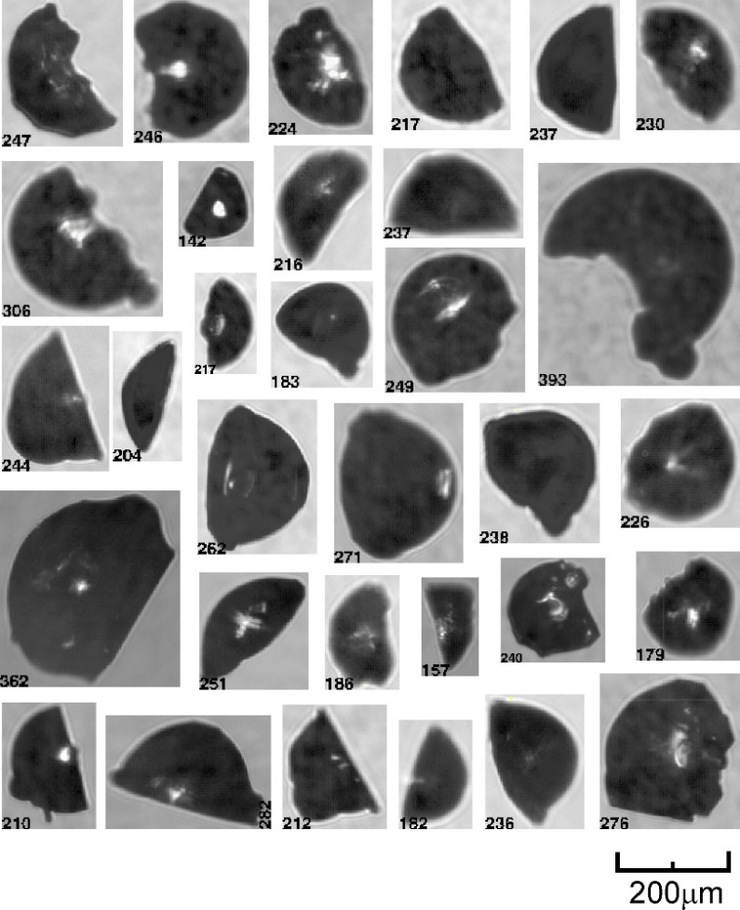
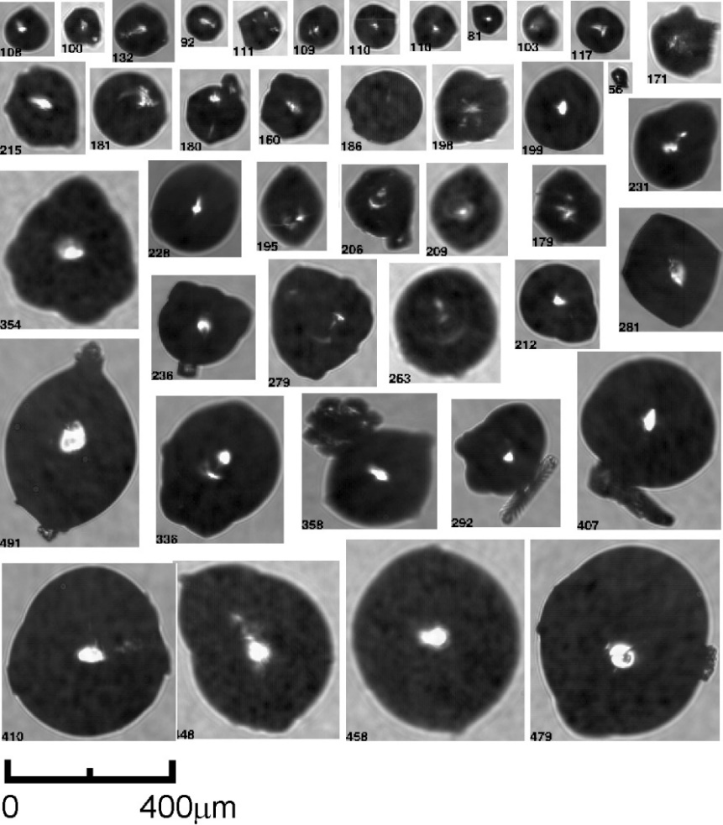
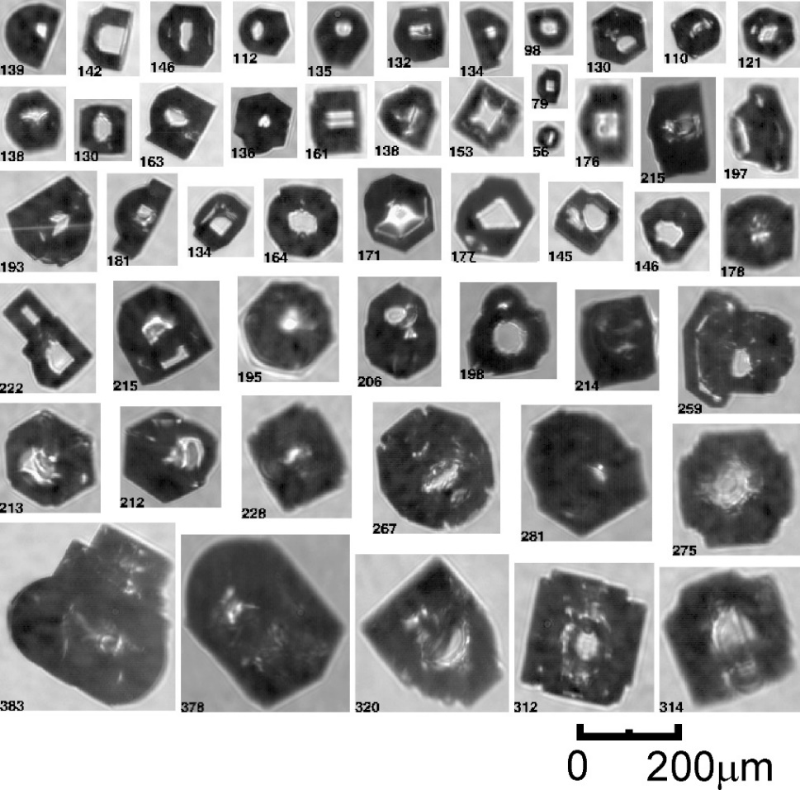
Shapes of Drops Frozen by Fragmented Ice
Korolev 2023
fragmented frozen drops -5<T<-1C
frozen drops
aged frozen drops
Development of facets on frozen drops
Drops may freeze poly- or monocrystalline
Metamorphosis of a frozen droplet shape
Korolev et al. (ACP, 2020)
Notes:
The next few slides discuss the recent findings regarding the evolution of ice crystals during SIP. This slide shows fragmented and deformed frozen droplets collected during SIP events. Such frozen droplets were observed in numerous lab experiments as well. After some time, the frozen drops develop facets and turn into regular facetted ice crystals. What is interesting about it, is the way, in which these frozen drops were nucleated. It should be said upfront, that the observed concentrations of the frozen drops and their fragments are too high at that temperature to be explained by heterogeneous nucleation. The most reasonable explanation is that these drops were nucleated by the ice splinters resulting from SIP. This brings up a question: What are the typical sizes of the splinters?

Slide 8
VIDEO of the Fragmentation of Frozen Drop (FFD) PROCESS
Wildeman et al. (Phys. Rev. Lett. 2017) High-speed video of millimeter supercooled (- 15°C) drop on a hydrophobic surface in a vacuum chamber.

Slide 9
Cloud Base Temperature is the main factor in predicting whether a cumulus cloud will generate a strong Coalescence Process.
The warmer the cloud base temperature, the deeper the region of warm cloud (i.e., the depth of cloud from its base to the 0°C temperature.)

Slide 11
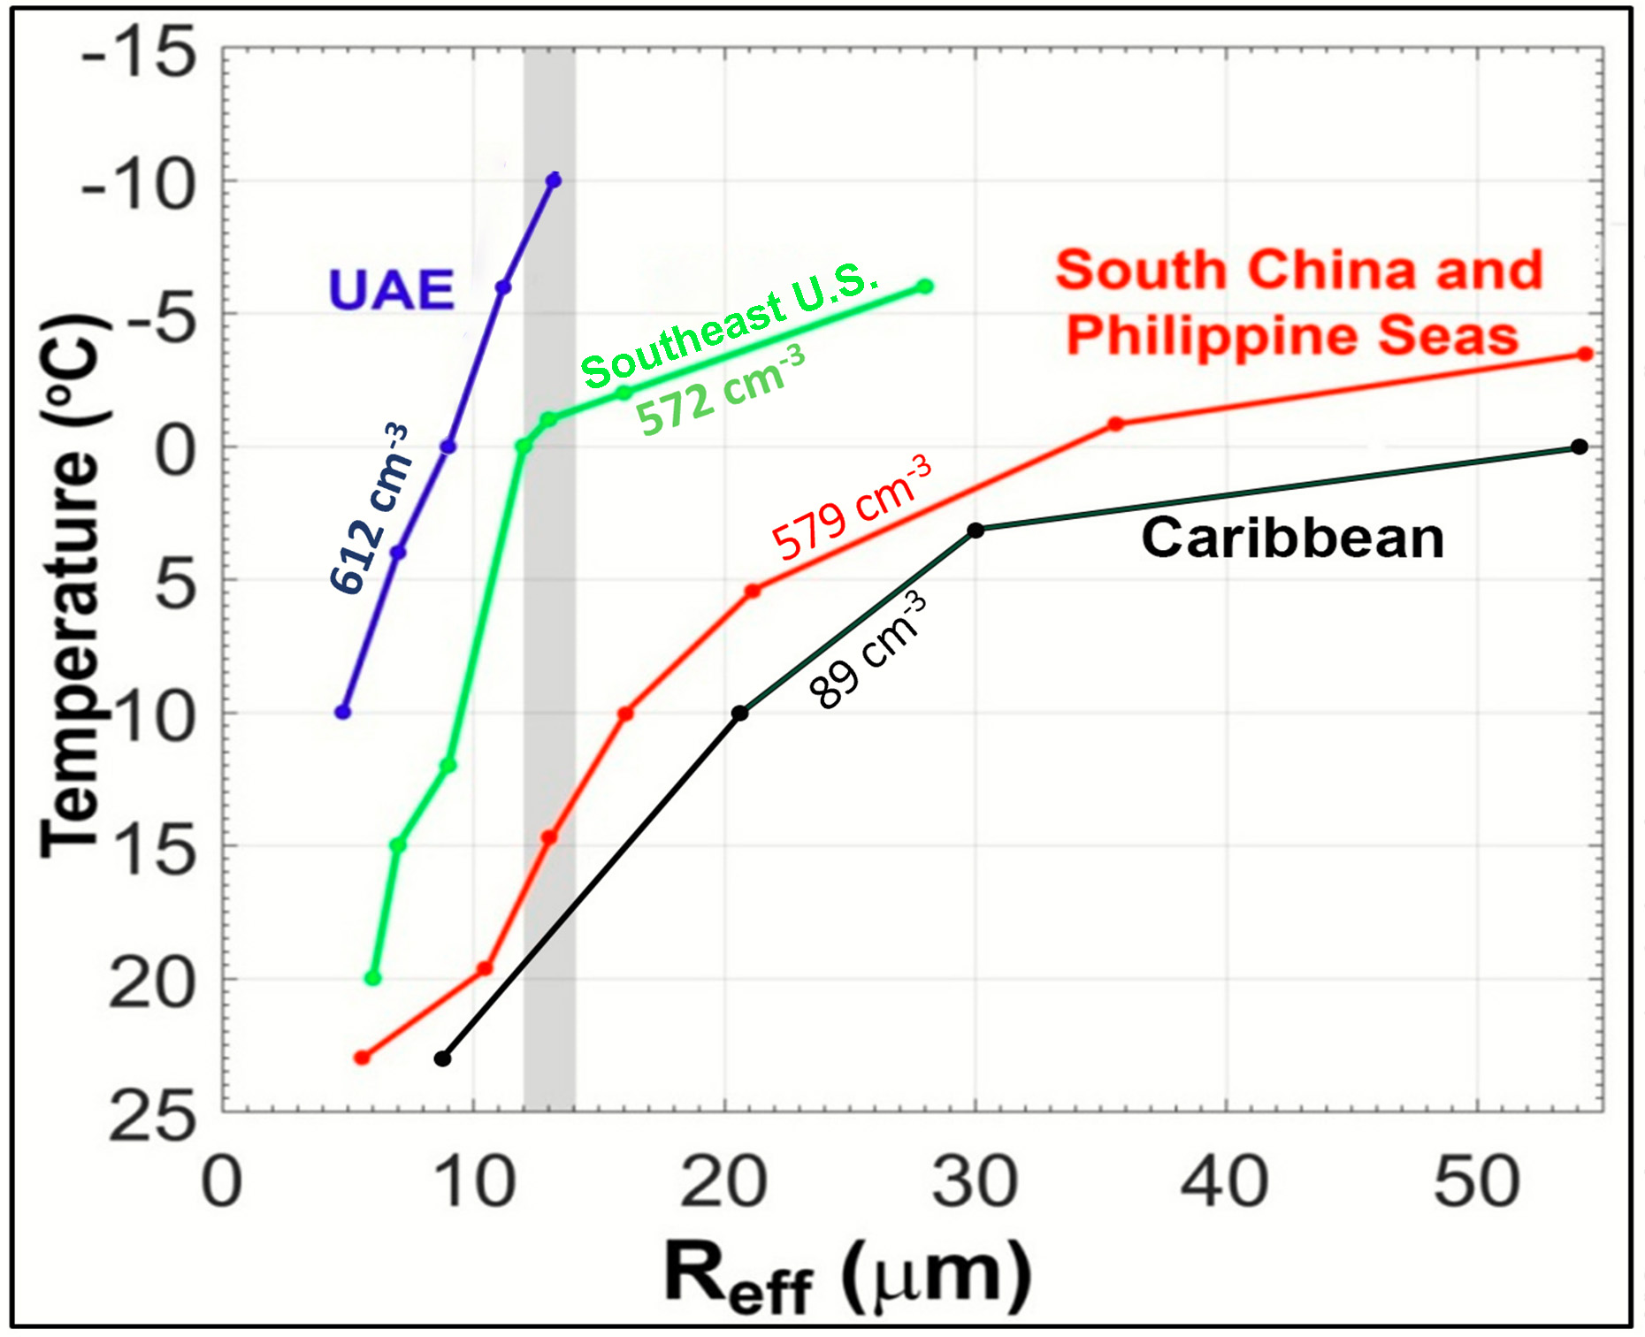
Effective Drop Radius (R_{eff}) as a
Predictor of Coalescence and the FFD SIP
Results from Recent Field Projects
Several investigators have found that R_{eff} > ~ 12 to 14 µm is indicative of an active coalescence process in Cumuli.
Rosenfeld and Gutman (1994); Freud and Rosenfeld (2012); Wehbe et al. (2021); Morrison, et al. (2021); Lawson et al. (2022)

Slide 12
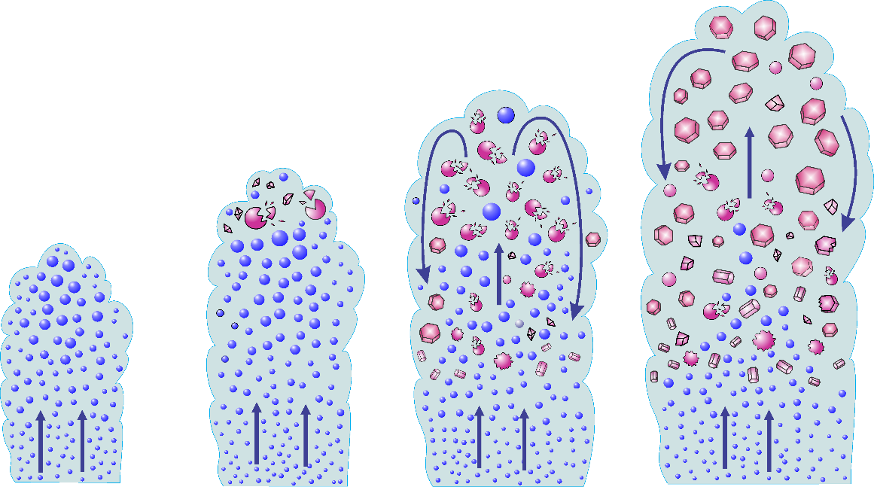
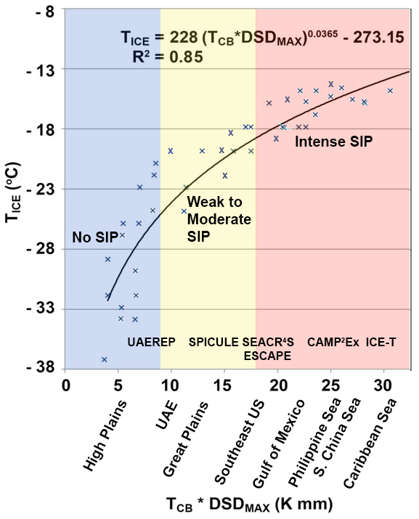
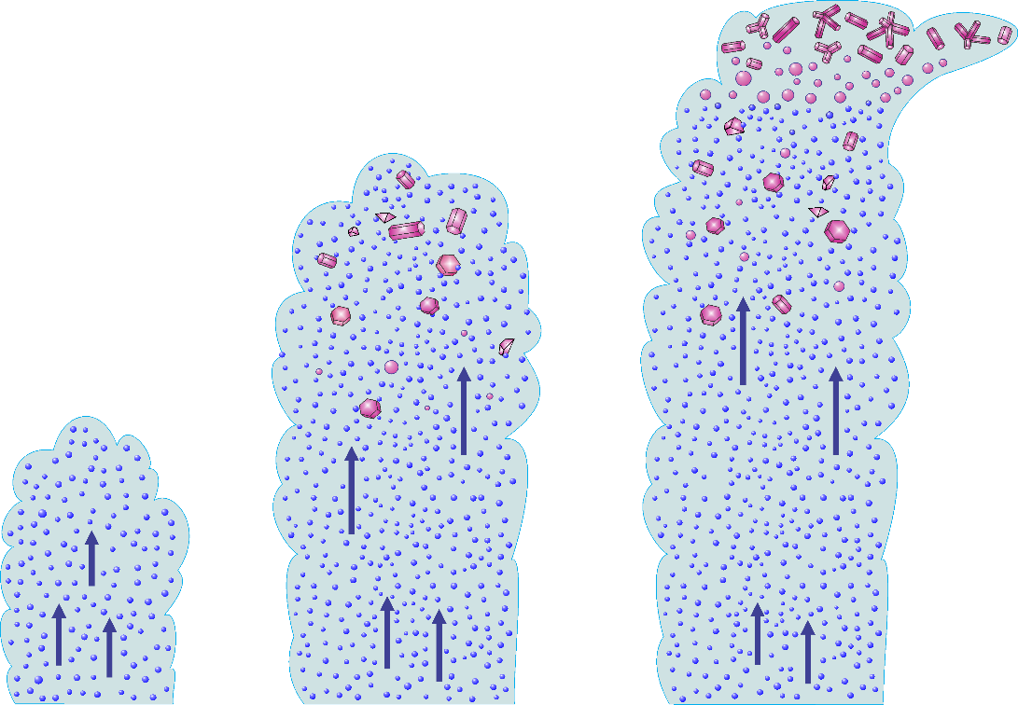
Parameters Controlling SIP Initiation in CuCG
Korolev 2023
High Plains Continental
T_{cb}< 8°C
N_{conc}> 500 cm⁻³
Intense SIP at T<-12ºC
Tropical Maritime
T_{cb}> 23 °C
N_{conc}<200 cm⁻³
10°C < T_{cb}< 18 ° C
200 < N_{conc} < 900 cm⁻³
No SIP
Primarily PIP at the initial stage
Lawson et al, JAS, 2022
Lawson et al, BAMS, 2023
Notes:
Presence of precipitation size drops is critical for the scenario shown in the previous slide. If the droplets are too small, then SIP will be hindered and ice formation will be predominantly controlled by primary ice nucleation. In his 2022 JAS paper, Paul Lawson, obtained conditions in convective clouds favorable for early SIP initiation. This diagram shows the dependence of the level of cloud glaciation versus the product cloud base temperature by max droplet size observed at the cloud base. If this product is low, then SIP is suppressed and glaciation occurs at temperatures approaching the temperature of homogeneous freezing. For the cases with a large product, the cloud produces numerous large drops due to intense collision-coalescence process and create conditions favorable for the initiation of secondary ice at relatively high temperatures.

Slide 13
What Effects do Aerosols (CCN) have on the Coalescence Process?

Slide 16
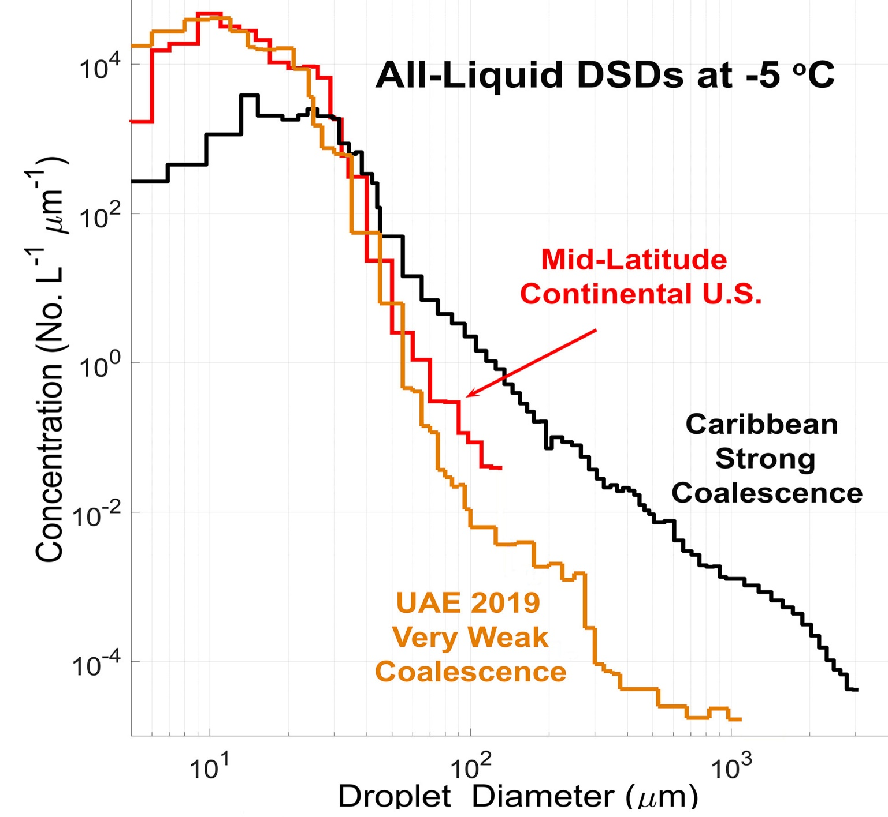
SPEC Learjet Measurements in Ice-free updrafts at -5°C

Slide 17
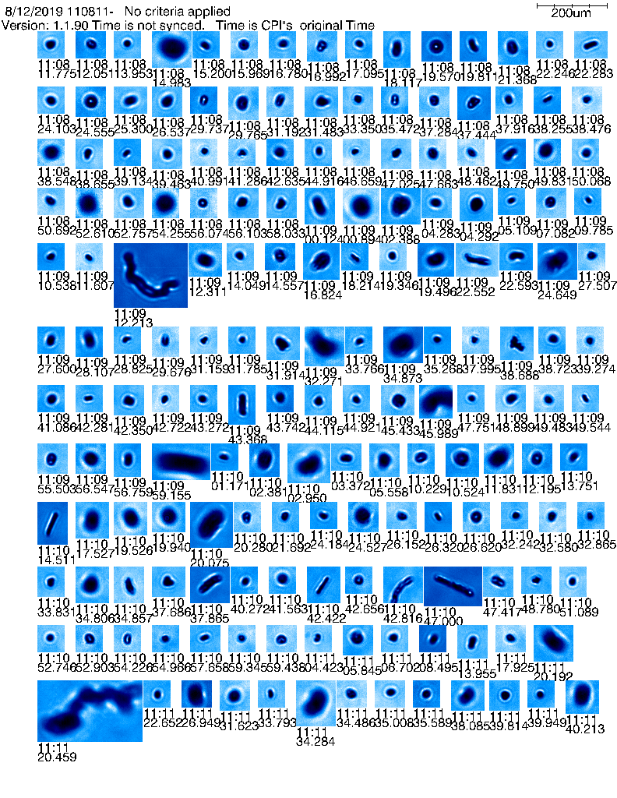
SPEC Learjet Measurements during SPICULE (5 June 2021)

Slide 18
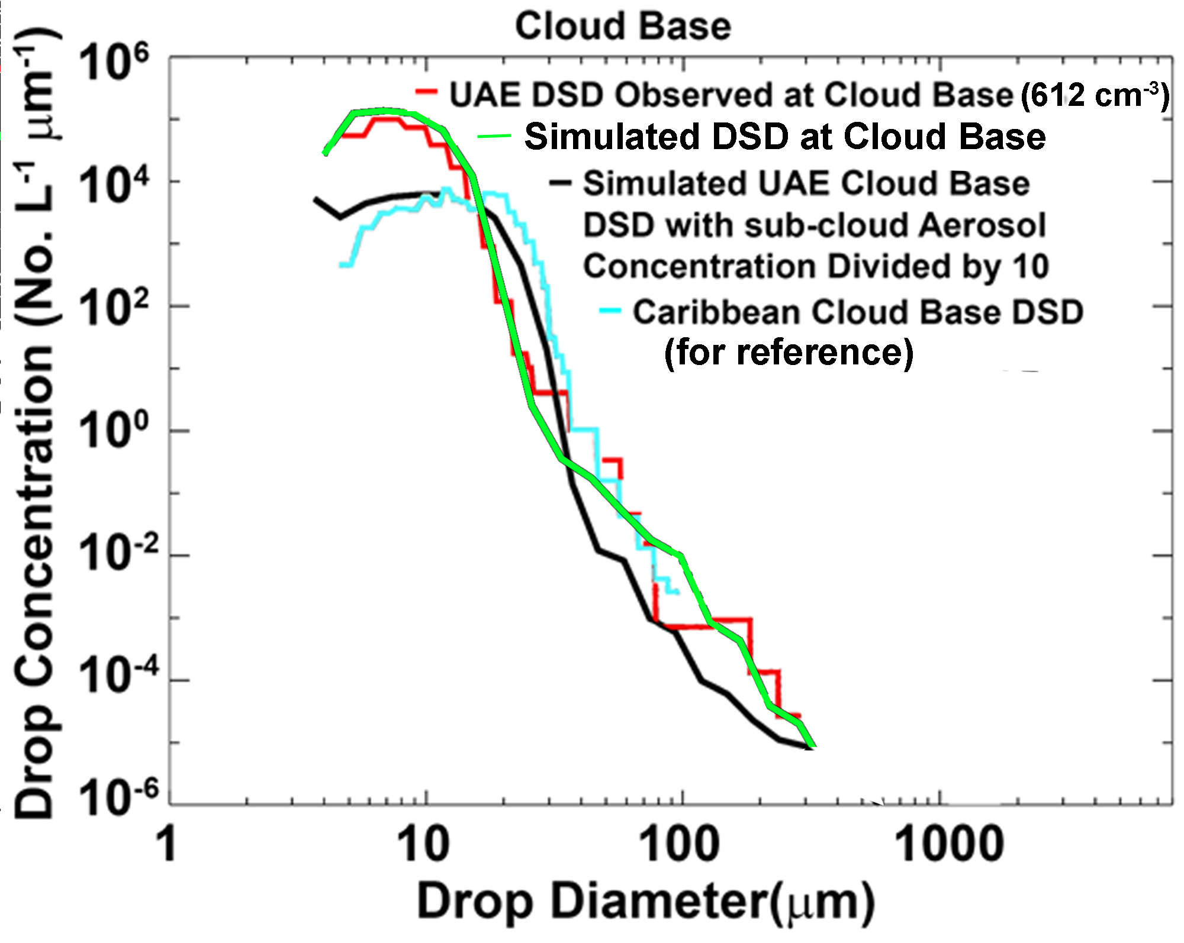
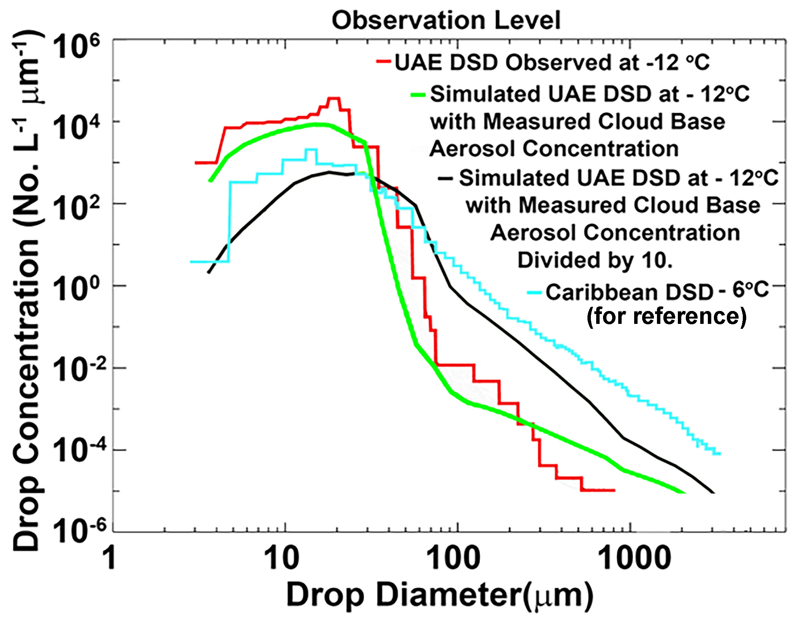
Effects of Reducing Cloud-base Aerosol Concentration on Coalescence:
Simulation of UAE 12 August 2019 CuCg (Morrison et al. 2021)

Slide 19
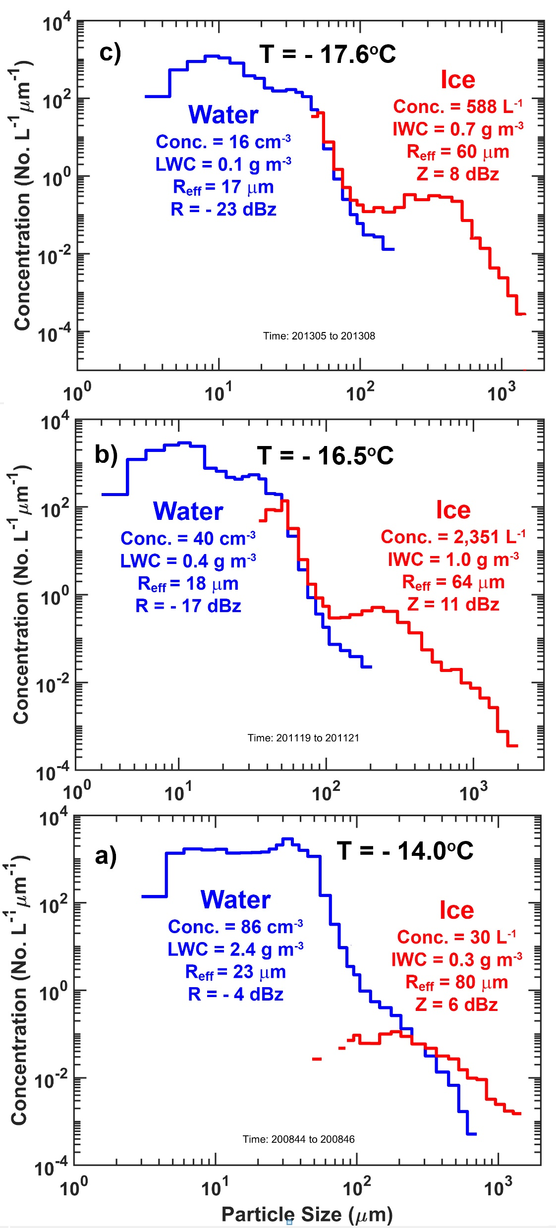
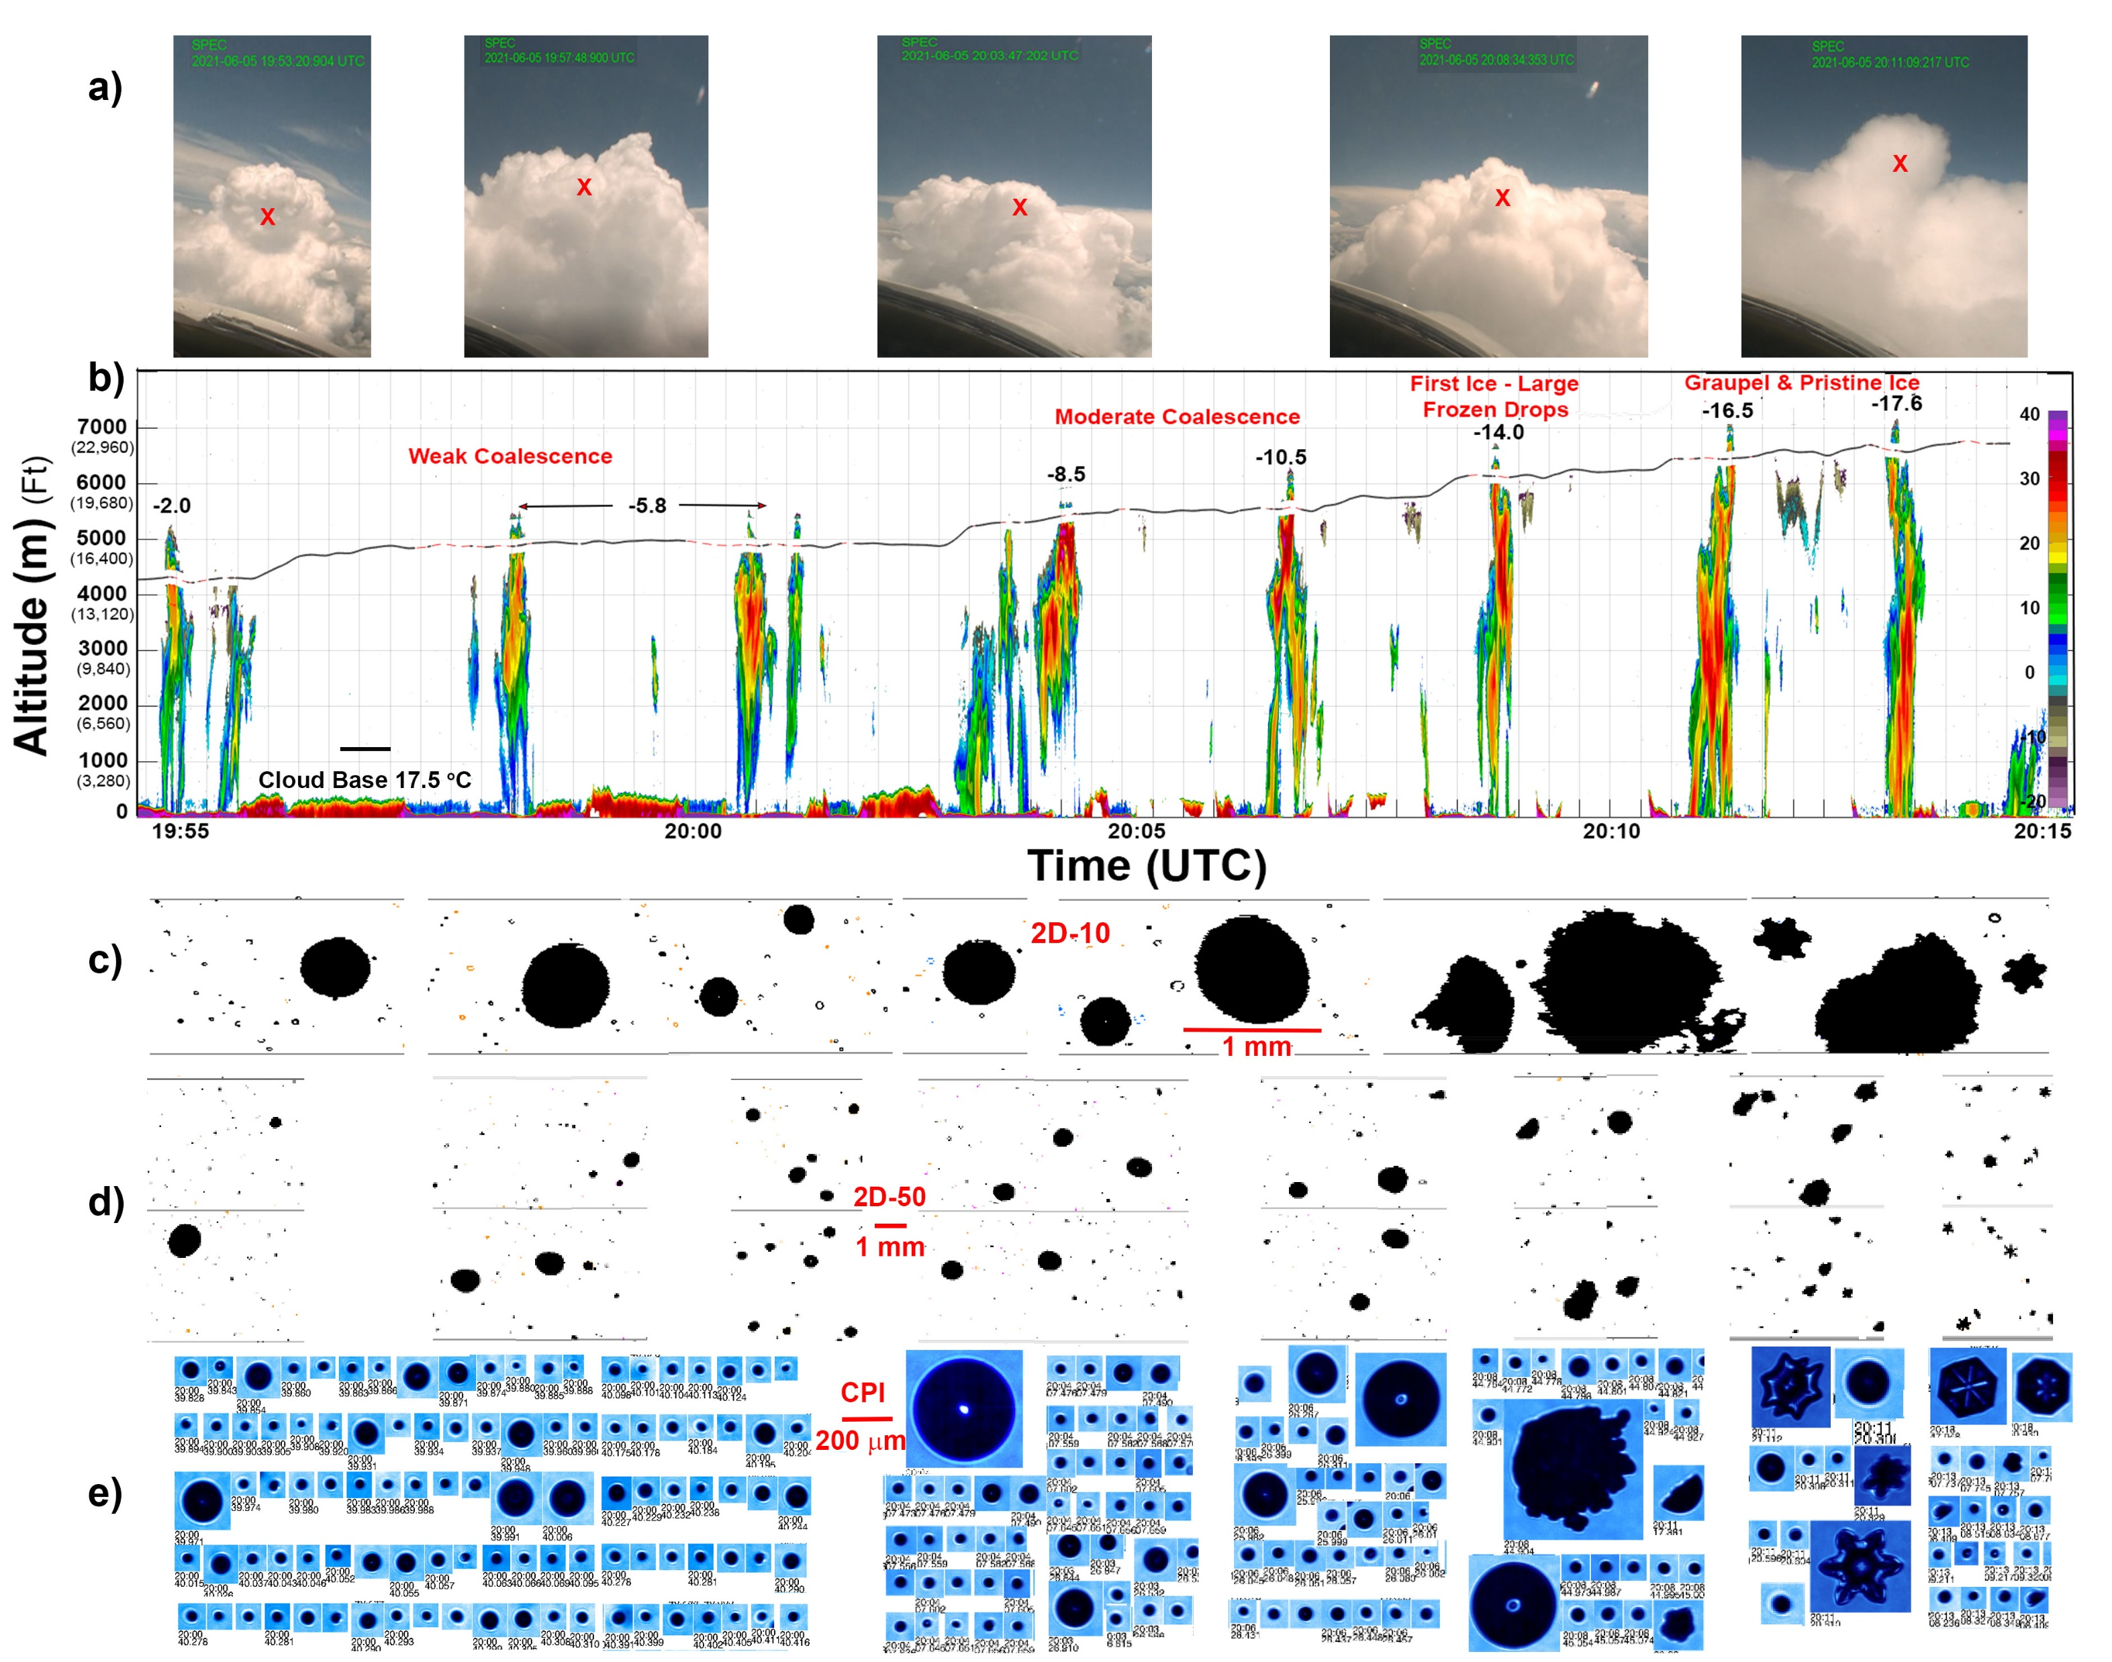
SPEC Learjet Measurements during SPICULE (5 June 2021)

Slide 20
Summary/Hypothesis
Cumulus clouds that produce (~ millimeter-diameter) Supercooled Large Drops (SLDs) in sufficient concentrations, e.g., Tropical Marine CuCg, rapidly glaciate via a Secondary Ice Process in the cloud region -5 °C > T > ~ -15 °C. Rapid glaciation can lead to enhanced precipitation.
Cumulus clouds that produce only small diameter (< ~ 50 μm) drops, e.g., High-Plains in the U.S., do not generate secondary ice and substantial SLW is carried well above the –15 °C level.
Cumulus clouds that produce SLDs in low concentrations, e.g., the UAE, may be stimulated via hygroscopic seeding to enhance the coalescence process, thereby producing SLDs and a Secondary Ice Process that Enhances Precipitation.

