Slide 1


Uncertainties and Limitations of the FCDP measurements during ATTREX 2011
Sara Lance
Presented at the ATTREX Science Meeting
Boulder, CO
11-12 June 2012

Slide 2
FCDP –
Fast Cloud Droplet Probe
Counts individual particles according to scattering signal
  Slightly Larger sample volume during ATTREX for better counting statistics in sub-visible cirrus
Sizes particles using pulse height analysis. Less precise for ice particles, due to
  Variable refractive index
  Non-spherical shape
Ability to count small ice particles
  Shattering of large ice particles will artificially enhance the concentration
  Do our best to account for that, shattering removal algorithm
  We verify this by comparing to other in-situ observations (FFSSP and 2D-S)
Aerosol contribution to measured concentrations is minimal
Notes:
Although designed for measuring cloud droplets, can also be used to count small (<50 um) ice particles.

Slide 3
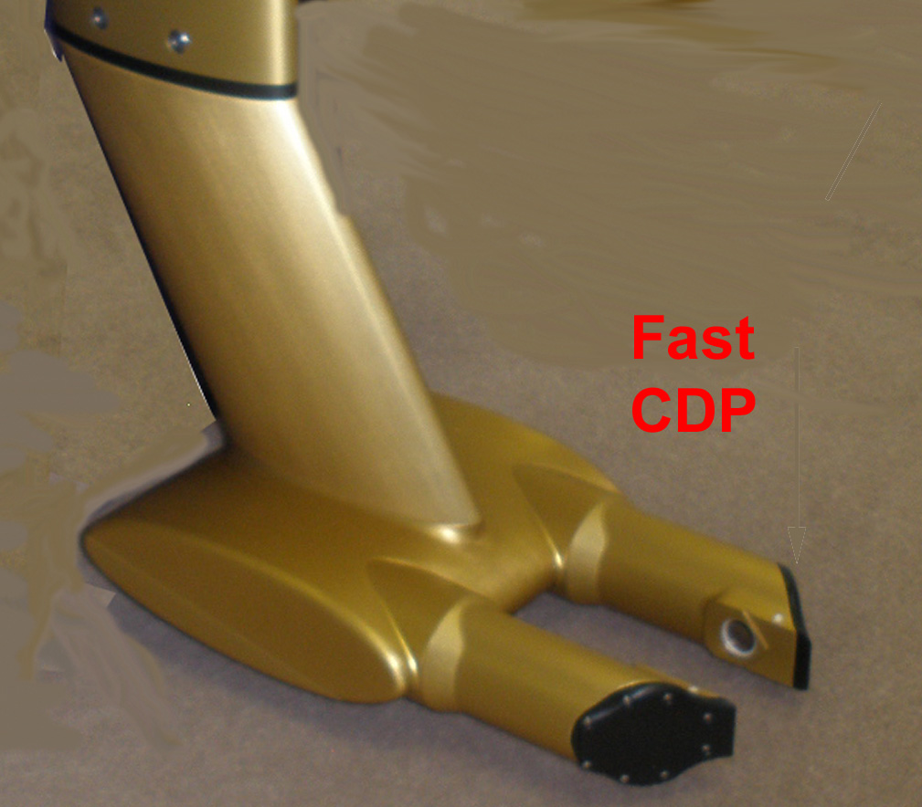
Fast-CDP
Knife edge tips to reduce artifacts cause by large ice particles shattering

Slide 4
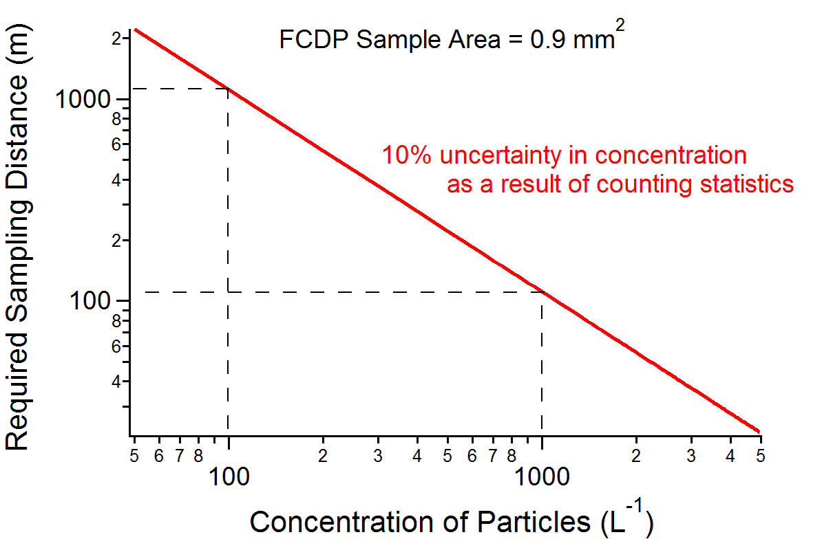
Statistical Sampling of Ice Particles by the FCDP
Ice concentrations typically much lower than cloud drop concentrations
Options for improving sampling statistics
  Use a larger sample area
  Average over longer time period (longer distance)
Notes:
At concentrations of 100/L, this requires at least 200-300 m of cloud sampling (ideally more like 1km). Ability to measure thin cloud layers (only 100 m thick)… TAS ~ 170 m/s

Slide 5
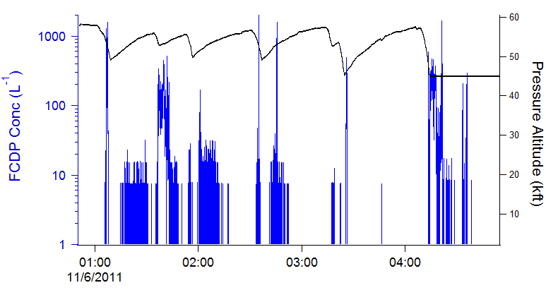
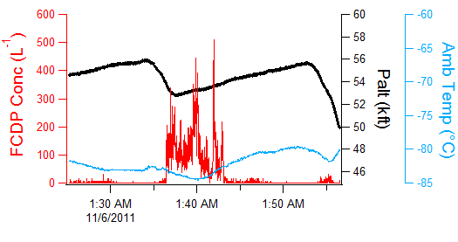
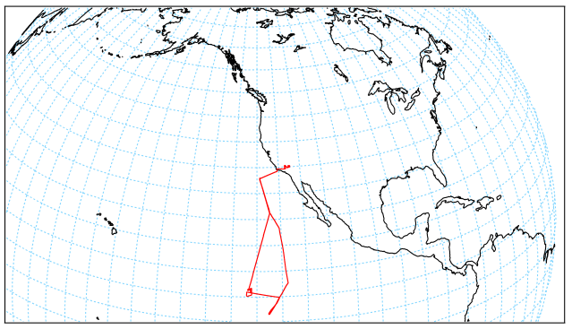
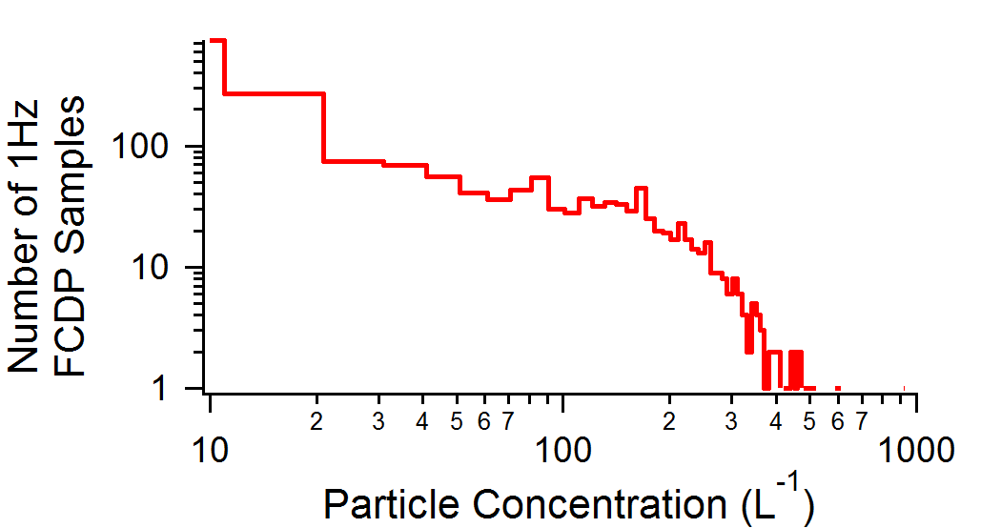
Concentrations observed during ATTREX
5-6 Nov 2011 Flight
Notes:
Layers at 45kft and 52-55kft

Slide 6
Concentrations observed during ATTREX
5-6 Nov 2011 Flight
Notes:
Layers at 45kft and 52-55kft

Slide 7
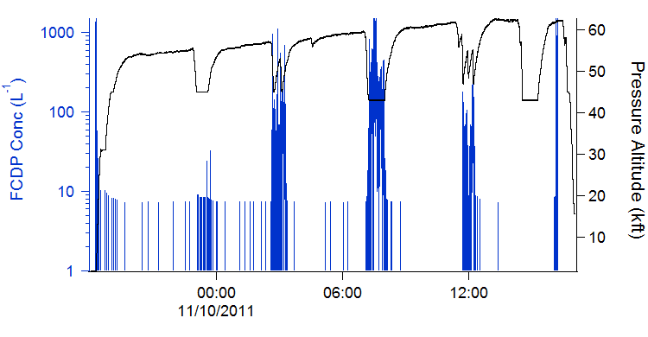
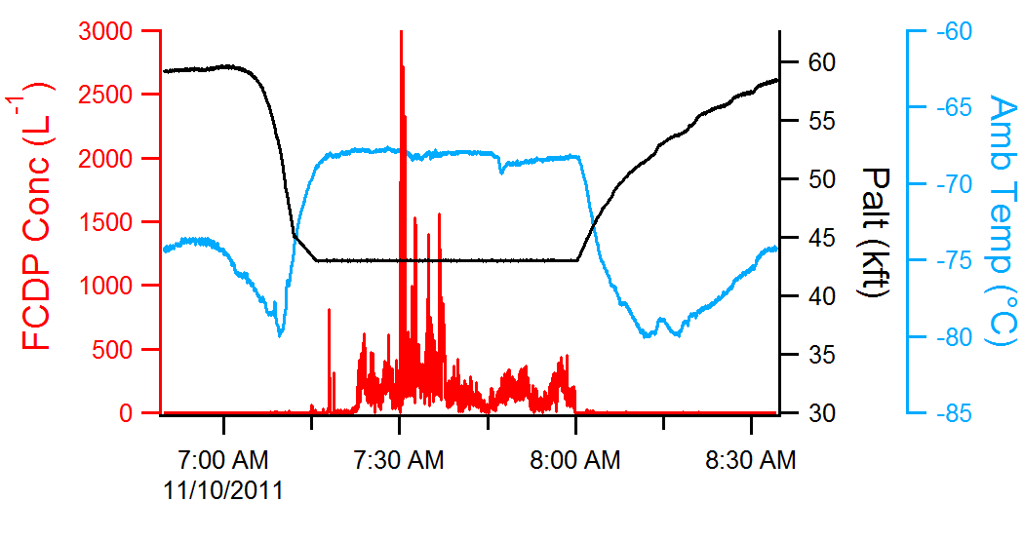
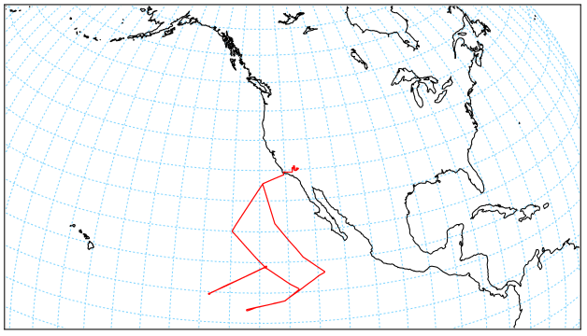
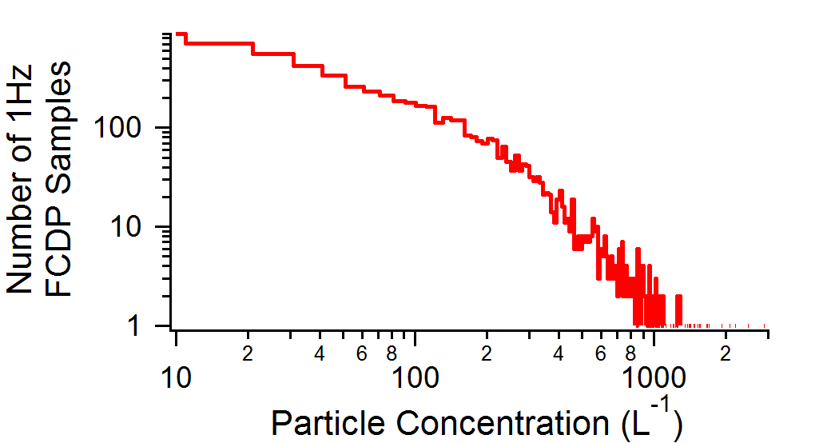
Concentrations observed during ATTREX
9-10 Nov 2011 Flight

Slide 8
Concentrations observed during ATTREX
9-10 Nov 2011 Flight

Slide 9
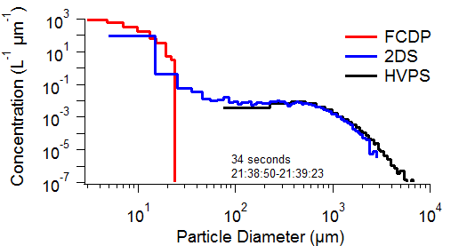
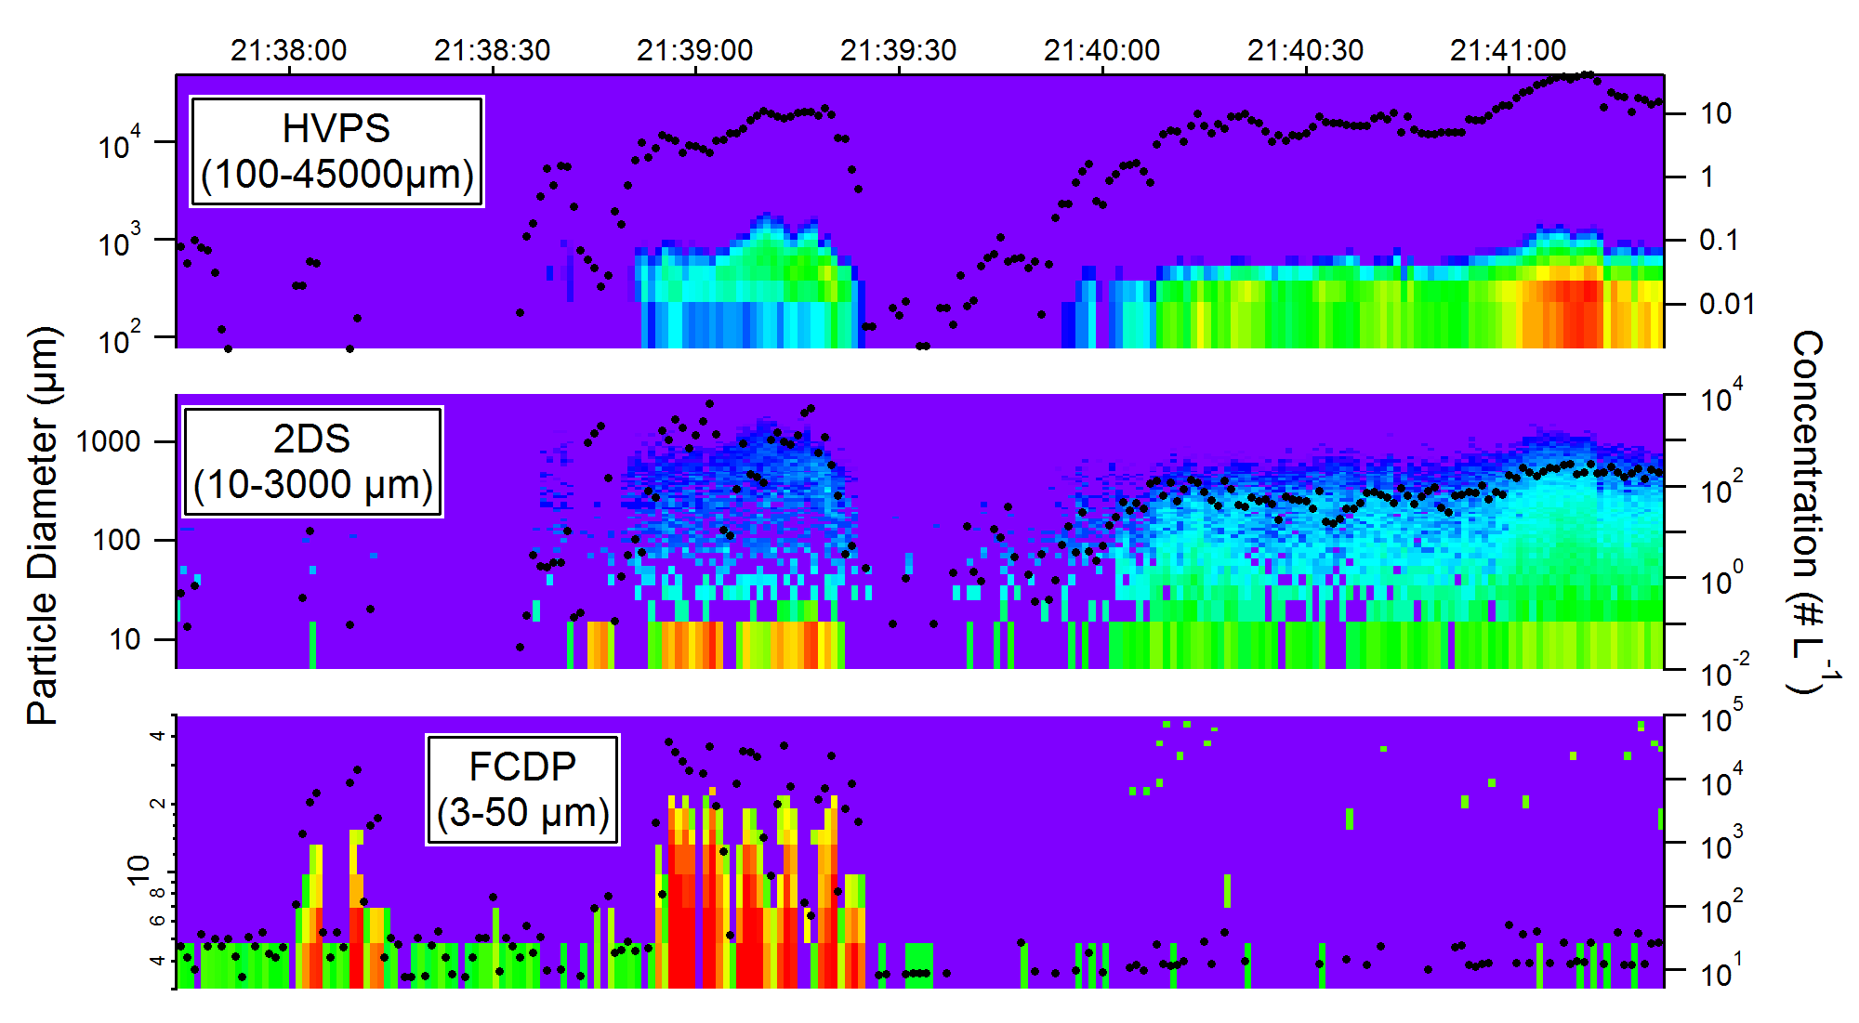
FCDP observations of small ice particles during LEAR Test Flight
Altostratus, Winter Park, CO
2 Sept 2011

Slide 10
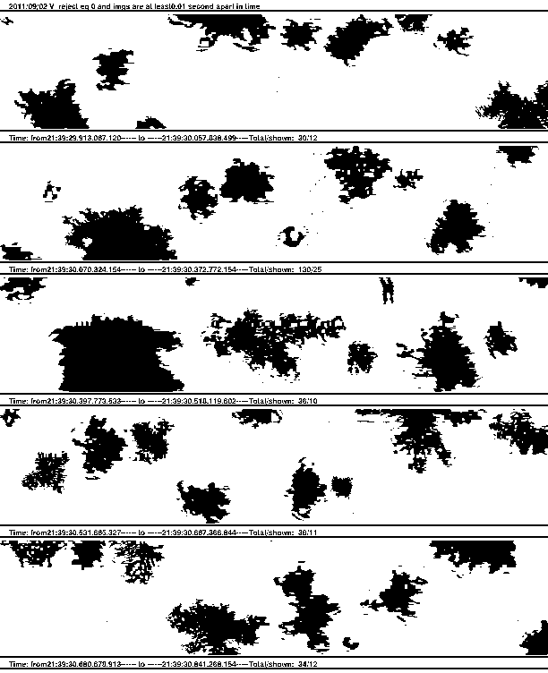
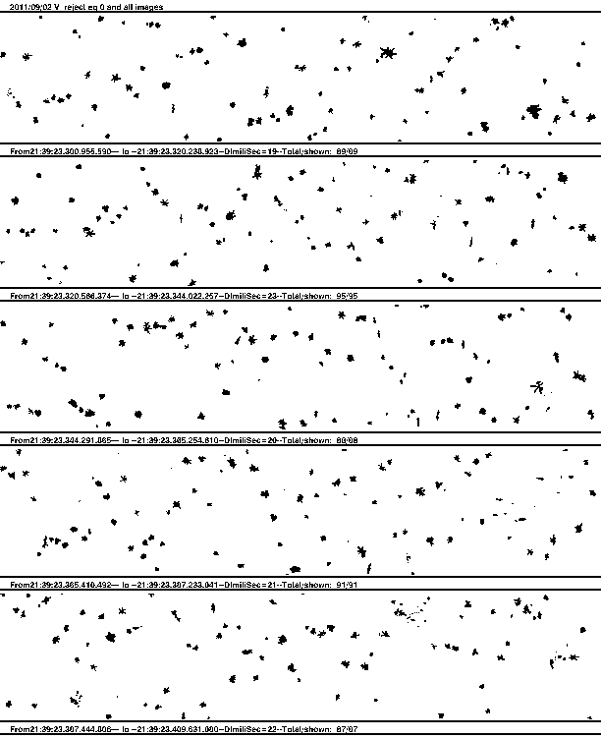
FCDP observations of small ice particles during LEAR Test Flight
Altostratus, Winter Park, CO
2 Sept 2011
2DS
HVPS

Slide 11
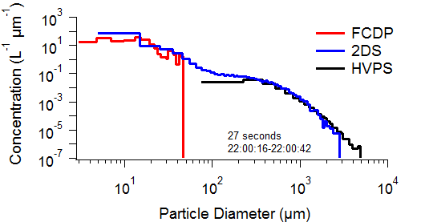
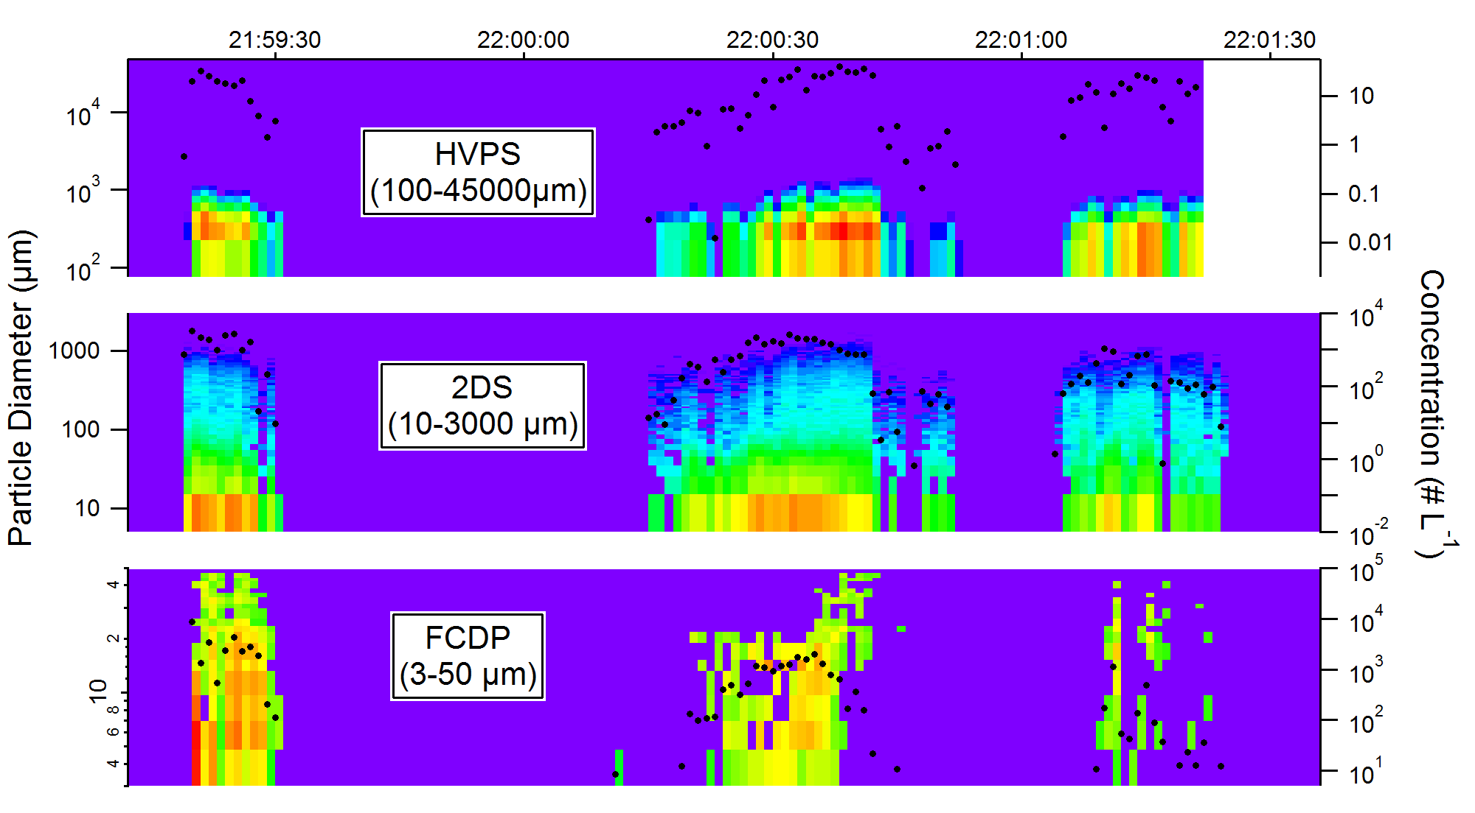
FCDP observations of small ice particles during LEAR Test Flight
Altostratus, Winter Park, CO
2 Sept 2011

Slide 12
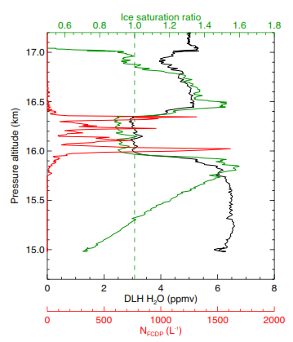
Inverse relationship between N_{FCDP} and S_{ice} observed during ATTREX 2011
5-6 Nov 2011
25.00-25.16 UT
Notes:
High Nice at 100% Sice, low Nice at 120% Sice

Slide 13
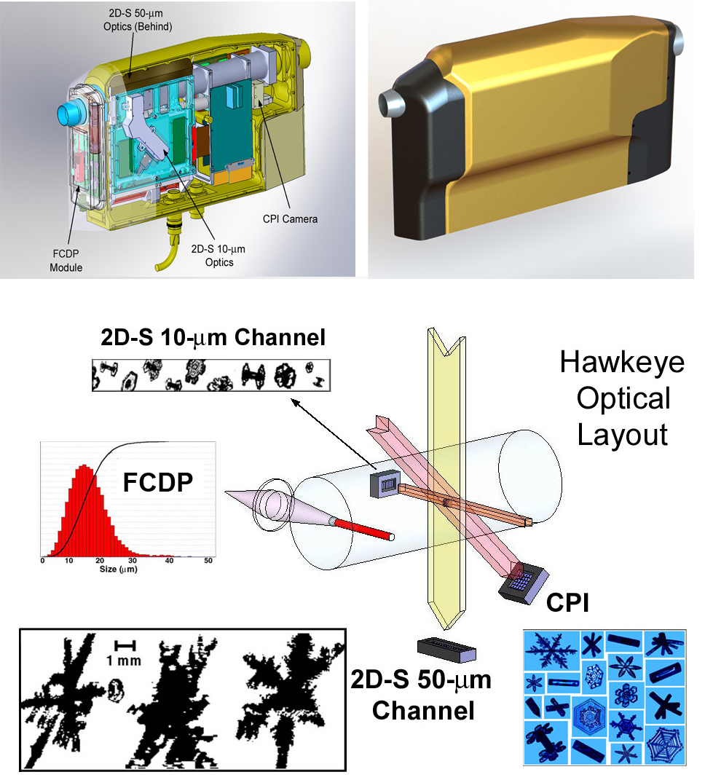
Hawkeye, ATTREX 2013
Notes:
(2) 10-um channels for the 2DS during ATTREX (not 50um and 10 um), since not expecting large ice particles. Recommend keeping standalone-FCDP under fuselage and Hawkeye under wing during ATTREX 2013 deployment.

Slide 14
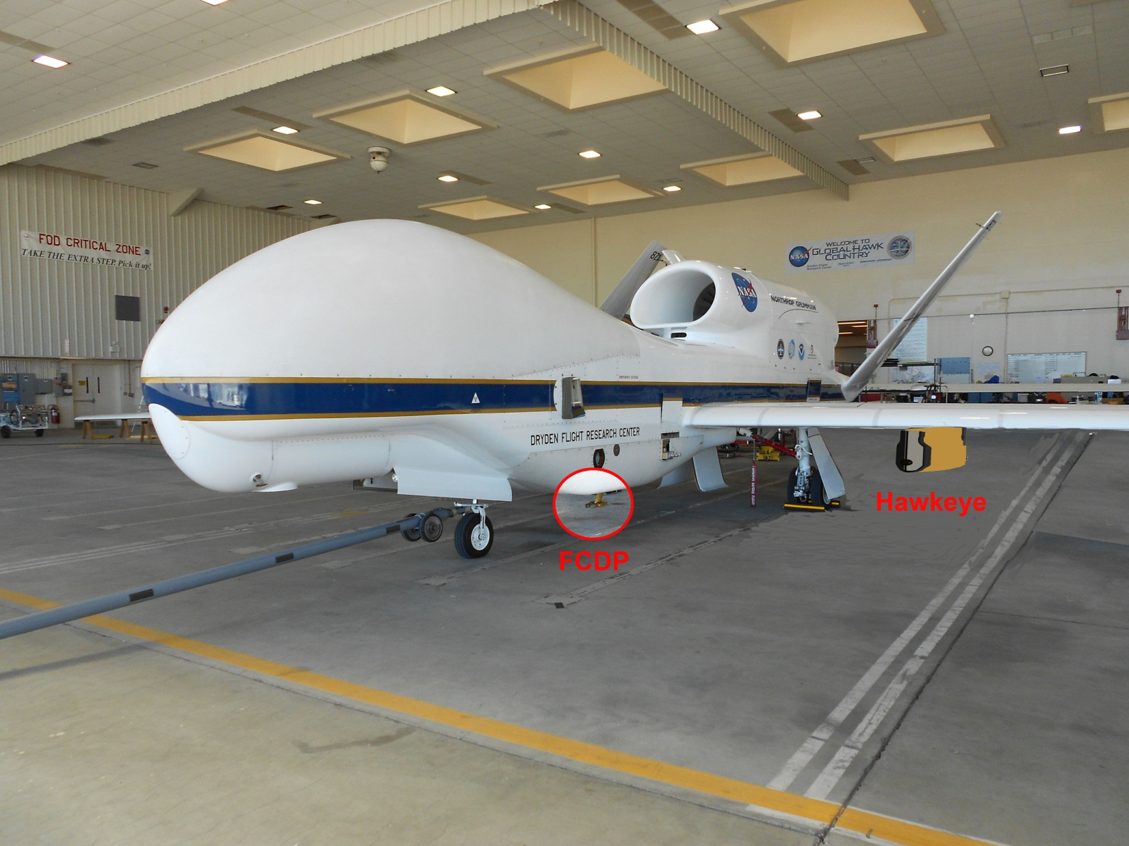
Hawkeye, ATTREX 2013

